Slide 1

Molecular Docking with Chimera and AutoDockVina
Part II
CCATS Group

Slide 2
The History of AutoDock [1]
Review: Goodsell, Sanner, Olson, and Forli, Protein Sci (2021). doi: 10.1002/pro.3934
AutoDock: Goodsell and Olson, Proteins (1990). doi: 10.1002/prot.340080302
AutoDock 4.2: Morris, Huey, and Lindstrom, Sanner, Belew, Goodsell, and Olson, J Comp Chem (2009). doi: 10.1002/jcc.21256
AutoDock Vina: Trott and Olson, J Comp Chem (2010). doi: 10.1002/jcc.21334
AutoDockFR: Ravindranath, Forli, Goodsell, Olson, and Sanner, PLoS Comput Biol (2015). doi: 10.1371/journal.pcbi.1004586
AutoDockCrankRep (peptide docking): Zhang and Sanner, Bioinformatics (2019). doi: 10.1093/bioinformatics/btz459

Slide 3
Choosing a Docking Engine [1]

Slide 4

The Scoring Function
[7] Huey, Morris, Olson and Goodsell, J Comput Chem (2007). doi: 10.1002/jcc.20634
The AutoDock force field is [7]
The free energy scoring function is
$$V=W_{vdw}\underset{i,j}{∑}\left[\frac{A_{ij}}{r_{ij}^{12}}-\frac{B_{ij}}{r_{ij}^{6}}\right]+W_{hb}\underset{i,j}{∑}E(t)\left[\frac{C_{ij}}{r_{ij}^{12}}-\frac{D_{ij}}{r_{ij}^{10}}\right]+W_{elec}\underset{i,j}{∑}\frac{q_{i}q_{j}}{ε(r_{ij})r_{ij}}+W_{sol}\underset{i,j}{∑}\left(S_{i}V_{j}+V_{i}S_{j}\right)exp\left(-\frac{r_{ij}^{2}}{2σ^{2}}\right)$$
$$ΔG=\left(V_{bound}^{L-L}-V_{unbound}^{L-L}\right)+\left(V_{bound}^{P-P}-V_{unbound}^{P-P}\right)+\left(V_{bound}^{P-L}-V_{unbound}^{P-L}+ΔS_{conf}\right)$$

Slide 5
The Search Algorithm
Needs to explore enough of the available conformational space in a timely manner
For a protein target, volumetric maps are precalculated [3]
the target protein is embedded in a grid
a probe attom is sequentially placed at each grid point
the interaction energy between the probe atom and the target is computed
the value for the interaction energy is saved on the grid
See also http://www.csb.yale.edu/userguides/datamanip/autodock/html/Using_AutoDock_305.1.html
AutoDock 4 Search is carried out by combining Lamarckian genetic algorithm and local search
AutoDock Vina search is carried out by combining Monte Carlo algorithm and local search

Slide 6
Virtual Screening
Automated evaluation of compound libraries for synthesis, purchase, or testing
Predicting the binding affinity of Venetoclax to Bcl-2 ~1 min
Does this mean we can only screen ~1,400 compounds/day ????
Maximize the use of computational resources, typically performed on a high performance cluster
The general protocol is:
Compound library preparation
Protein preparation
Your favorite docking program

Slide 7
Compound Libraries
NCI Diversity Sets (https://wiki.nci.nih.gov/display/ncidtpdata/compound+sets)
Zinc Database (https://zinc.docking.org)
These files should contain 3D coordinates for the compound of interest
For virtual screening with AutoDock Vina, the compound files must be PDBQT format
Custom libraries
ChemDraw
RDkit
Obabel

Slide 8
Tutorial
Goal: Virtually screen Bcl-2 (PDB 6O0K) to identify new compounds for the BH3-binding domain
Compound library contains the NCI Diversity Set 5 (99/1593 compounds), and Venetoclax
Docking with AutoDock Vina:
Single compound
Virtual Screening
Without using external libraries
With GNU Parallel (1, 2, 4, or 8 cores/job)
PDBQT files can be made with AutoDock Tools (https://ccsb.scripps.edu/mgltools/downloads/)
In this tutorial, the *.receptor.pdbqt and search box information was obtained from last weeks Bcl-2 docking. The Diversity Set 5 compounds was converted with OBabel.

Slide 9
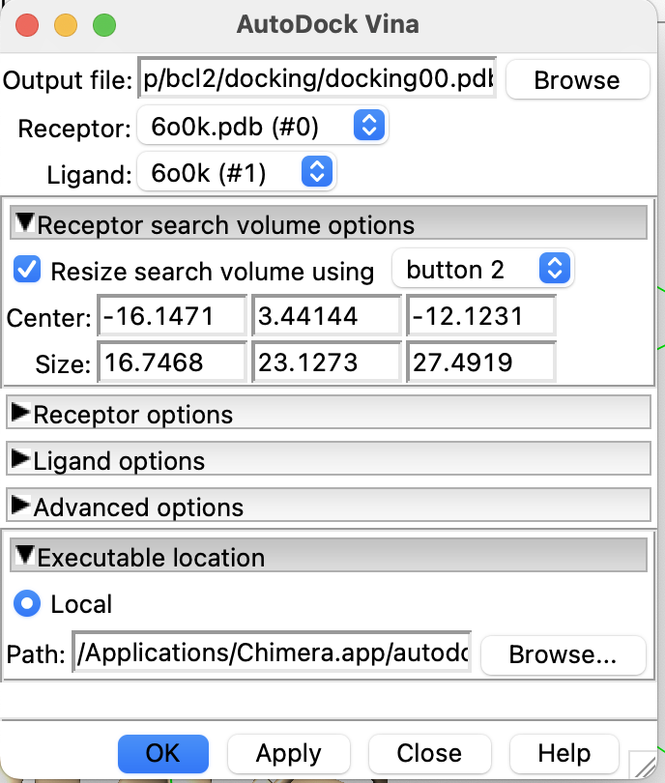
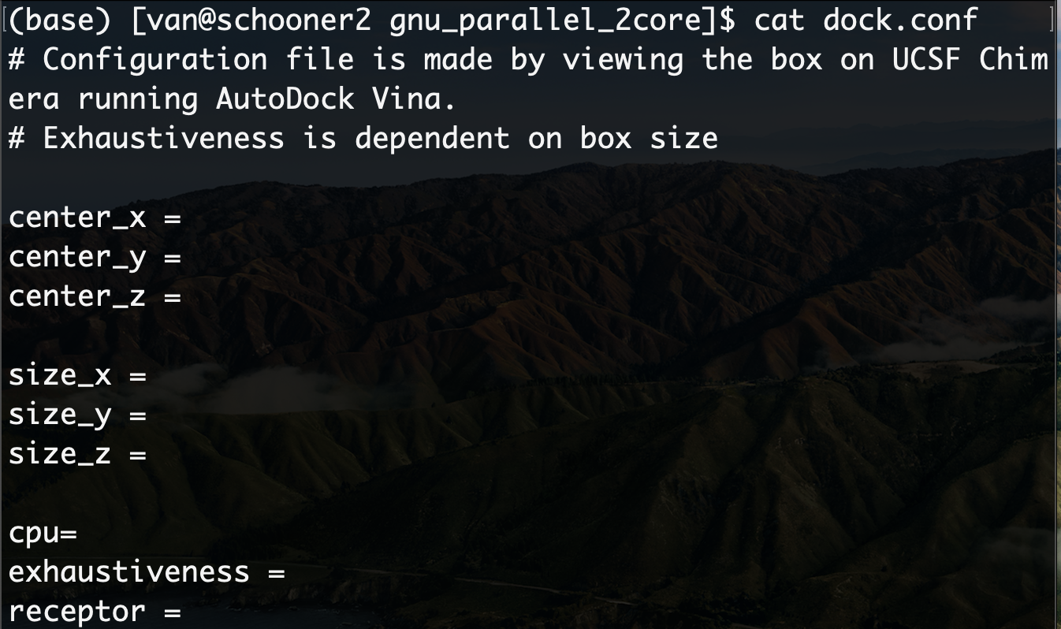
dock.conf Example
Exhaustiveness - number of independent runs from random initial configurations
Each run: 1) random perturbation, 2) local optimization (evaluates scoring function), and 3) selection

Slide 10
Docking Venetoclas to Bcl-2 (Command Line)
Files:
venetoclax.pdbqt (ligand)
6o0k_protein_clean.pdbqt (receptor)
dock.conf (information on protein file, search box, and CPU)
rundocking.slurm (SLURM submission script to run vina on HPC)
Steps:
Modify the dock.conf file to include search box info from previous tutorial
Run job:
sbatch rundocking.slurm

Slide 11
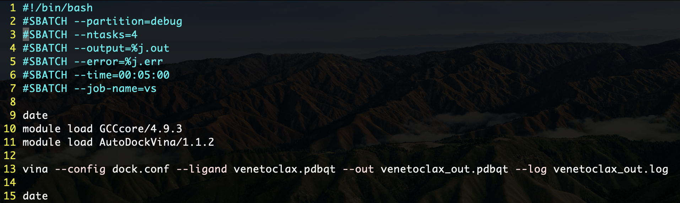
ventoclax (rundocking.slurm - the submitting script)
First line is always the shebang
SLURM batch commands for submitting jobs
Partition - group of nodes based on hardware (debug is for short 30 min jobs)
ntask - # of tasks expected
Output/error - gives output/error file with job ID as name
Time - requested time
Using software installed on OSCER
Once the modules are loaded you can call “vina”
- - config : point to the configuration file
- - ligand : point to the ligand file
- - out : output the docking result
- - log : print a log file

Slide 12
virtual_screening
gnu_parallel_2core (Uses GNU parallel to optimize serial jobs)
dock.conf (information on protein file, search box, CPU)
Compounds (compound library)
Receptor (protein)
setup.sh (makes a list of compound names; returns job_id.index)
rundocking.sh (Takes argument, finds compound, runs Vina)
runparallel.slurm (submission script for VS, 2 cores/job (10 jobs)
The folder is organized as follows:
Docking (template files)
no_external_lib (Made for readability)
dock.conf (information on protein file, search box, and CPU)
Compounds (compound library)
Receptor (protein file)
setup.sh (makes a list of compound names; returns job_id.index)
rundocking.slurm (submission script for VS of 10 compounds at a time)
Results (Contains my docking results and CPU test runs)

Slide 13
no_external_lib (~13 min)
Go to the folder
Cd virtual_screening/no_external_lib
Prepare the compound list by:
Bash setup.sh
Modify the dock.conf for the search volume, CPU, and location of the protein file
Submit the SLURM script:
Sbatch rundocking.slurm

Slide 14
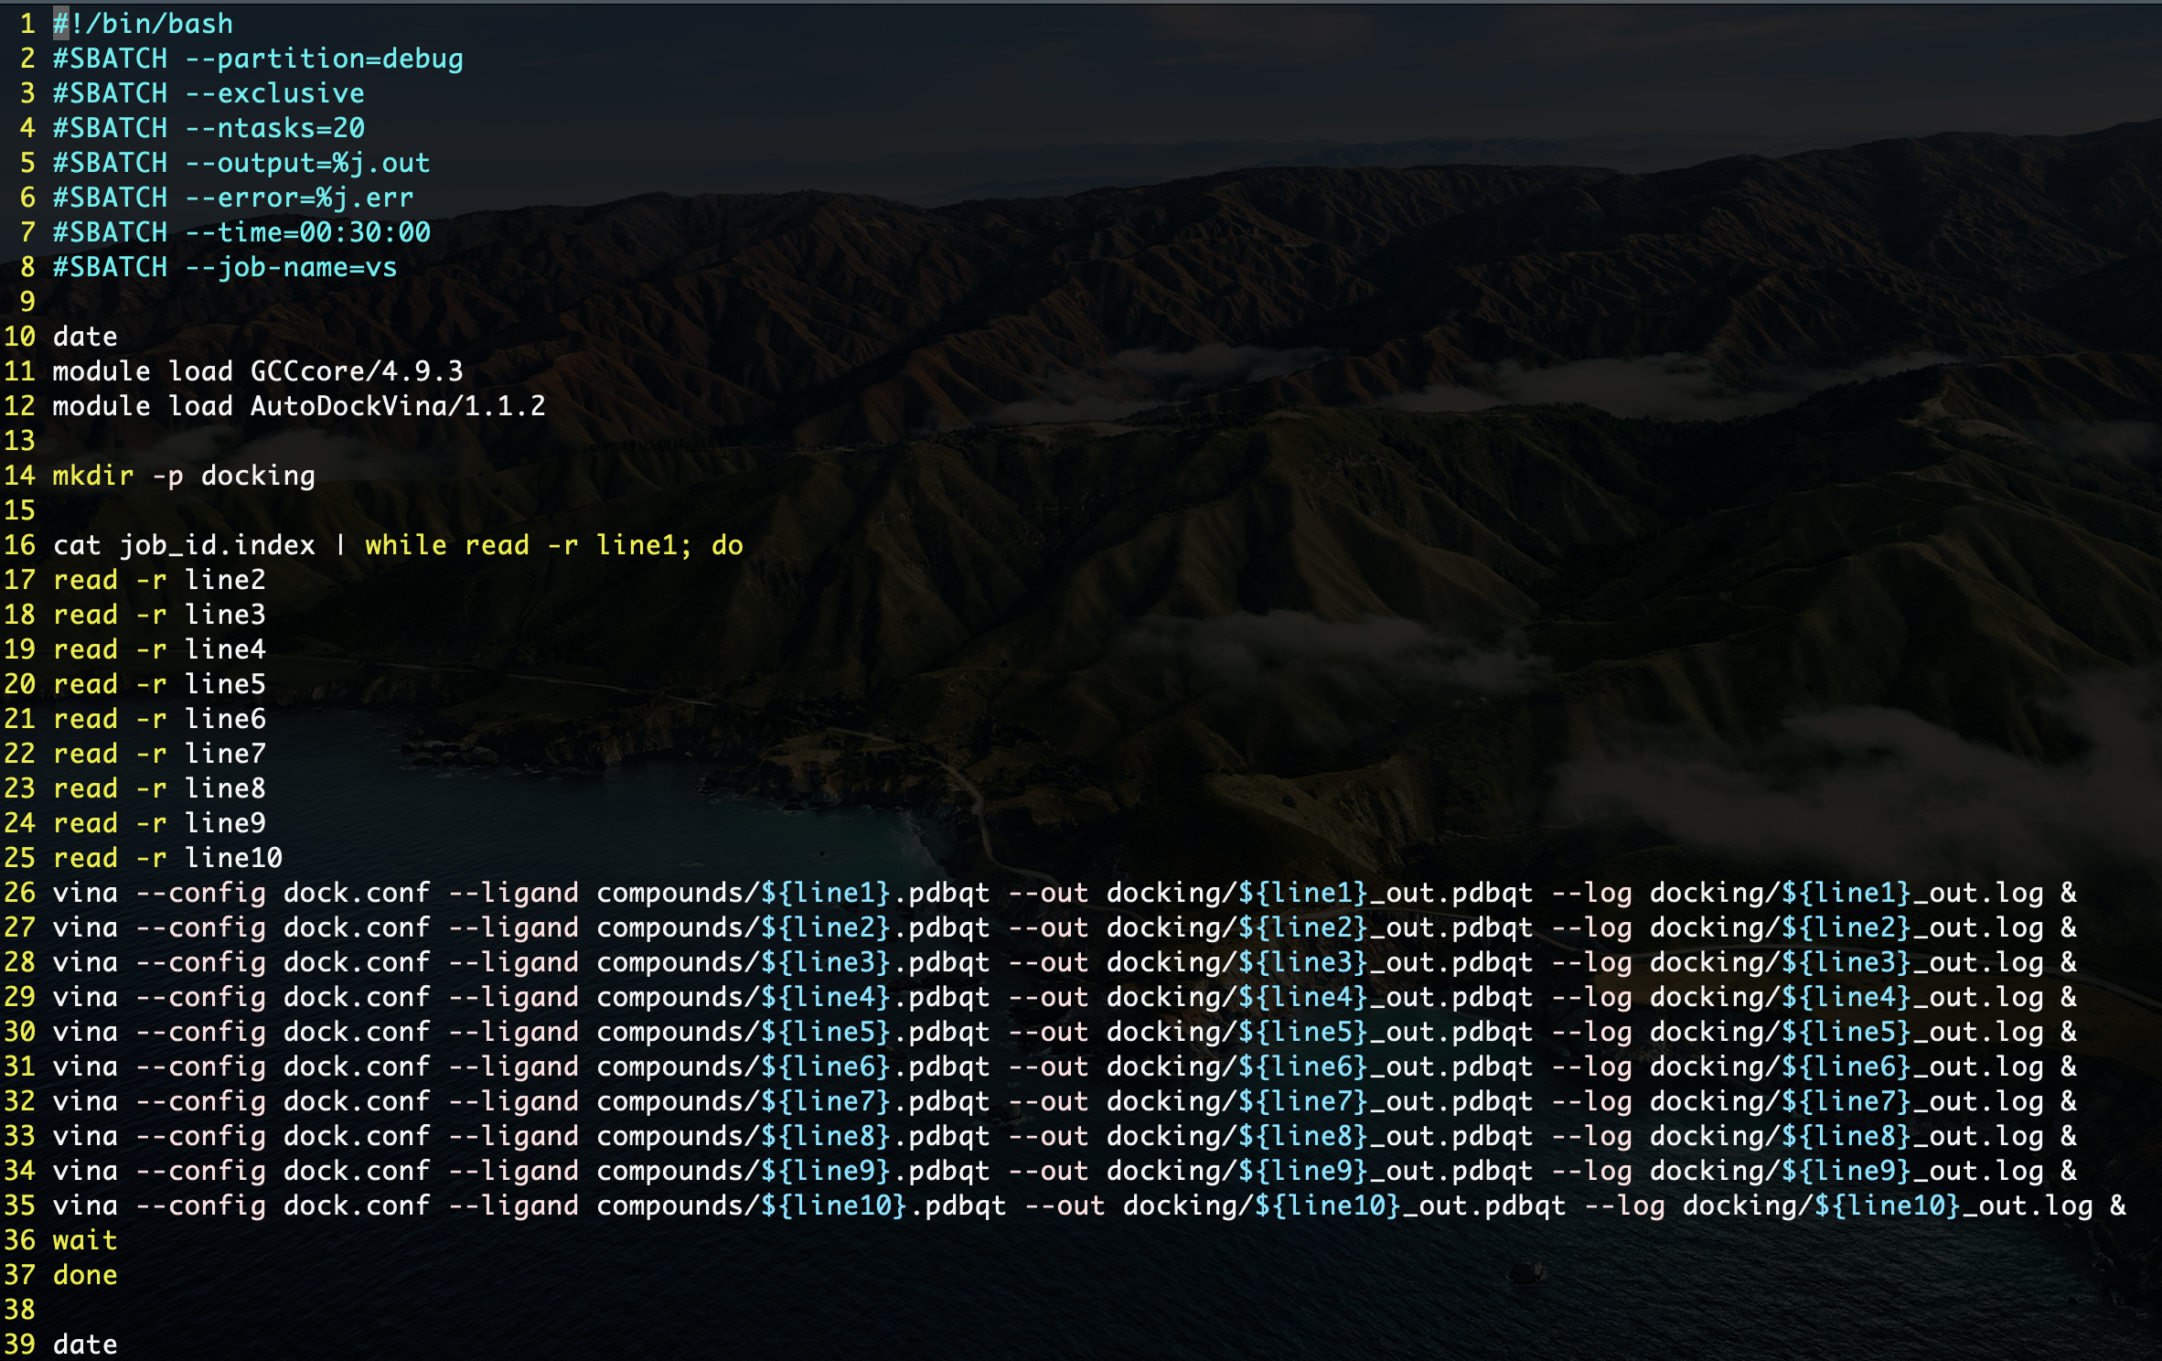
no_external_lib (rundocking.slurm - the submitting script)
First line is always the shebang
SLURM batch commands for submitting jobs
Partition - group of nodes based on hardware (debug is for short 30 min jobs)
Exclusive - request entire node to yourself
ntask - # of tasks expected
Output/error - gives output/error file with job ID as name
Time - requested time
Using software installed on OSCER
Makes docking folder
Open the file job_id.index, read 10 lines, run vina for each line in the background, and then wait for all jobs to finish before running the next 10 lines.

Slide 15
gnu_parallel_2cores (~11 min)
From the no_external_lib folder, we can go to this folder by:
Cd ../gnu_parallel_2cores
Prepare the compound list by:
Bash setup.sh
Modify the dock.conf for the search volume, CPU, and location of the protein file
Could be copied from the previous folder by: cp ../no_external_lib/dock.conf .
Submit the SLURM script:
Sbatch runparallel.slurm

Slide 16
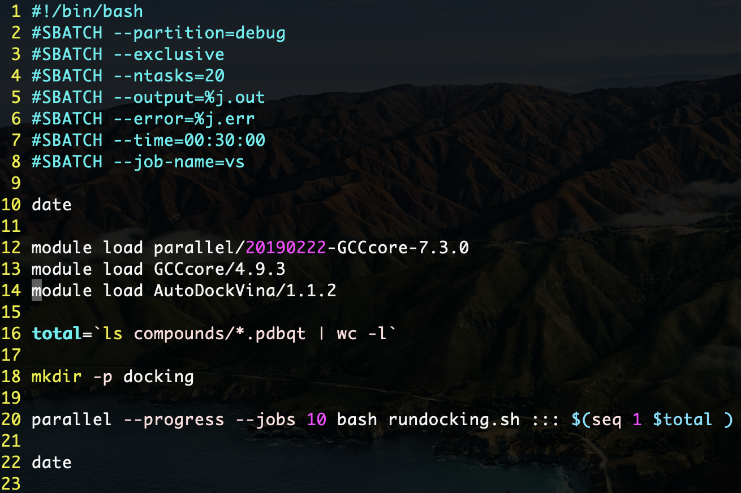
gnu_parallel_2cores (runparallel.slurm - the submitting script)
First line is always the shebang
SLURM batch commands for submitting jobs
Partition - group of nodes based on hardware (debug is for short 30 min jobs)
Exclusive - request entire node to yourself
ntask - # of tasks expected
Output/error - gives output/error file with job ID as name
Time - requested time
After loading GNU Parallel, change the compiler to an older version for Vina
The variable “total” is the output of commands shown in backquotes (returns single number)
Makes docking folder
Parallel is the program that will manage our serial jobs.
- - progress : job progress information printed in the SLURM error file
- - jobs # : run up to # jobs in parallel
Bash rundocking.sh : execute the rundocking.sh script
::: $seq( 1 $total) argument for parallel is a sequence of numbers from 1 to the variable total

Slide 17

gnu_parallel_2cores (rundocking.sh - the docking script)
First line is always the shebang
The variable “compound” is the output of the commands in backquotes (returns the compound name based on line number)
AWK is a function for text/data processing, NR is built in AWK variable to return line (NR = number of records)
$1 is the first argument given to the bash script
i.e. In the runparallel.slurm script, the first job ran:
bash rundocking.sh 1 ( bash <script> <argument 1> .. )

